Slide 1

J K K NATTRAJA COLLEGE OF ENGINEERING AND TECHNOLOGY
Team Members:
Kabilan.B
Nisanth.V
Sakthivel.S
Vimal.D
Surya.R
Mentor:
MURUGASHANKAR S AP/IT
Domain : Applied Data Science
Title : Covid-19 Vaccines Analysis

Slide 2
Abstraction
The Covid-19 pandemic has brought to light the critical importance of vaccines in controlling the spread of infectious diseases. The development and distribution of Covid-19 vaccines have been a monumental challenge for global healthcare systems. To address this issue, we propose an innovative approach to analyzing Covid-19 vaccines and optimizing their distribution.

Slide 3
Description:
Our project focuses on using advanced technology to improve the distribution of Covid-19 vaccines. We'll use AI and data analysis to ensure vaccines get to the right places at the right times, and we'll also provide accurate information to the public. This project aims to make the vaccine rollout more efficient, reduce waste, and help us respond better to future health crises.

Slide 4
About_Project
Sources:
Dataset: COVID-19 in India form Kaggle
In this project we perform a load the data into pandas and preprocessing then other actions.

Slide 5
Data Preprocessing:
Clean the data: Address missing values, remove duplicates, and correct any errors in the dataset.
Transform the data: Convert data into a format suitable for analysis, such as date formatting, data type conversions, and data aggregation.

Slide 6
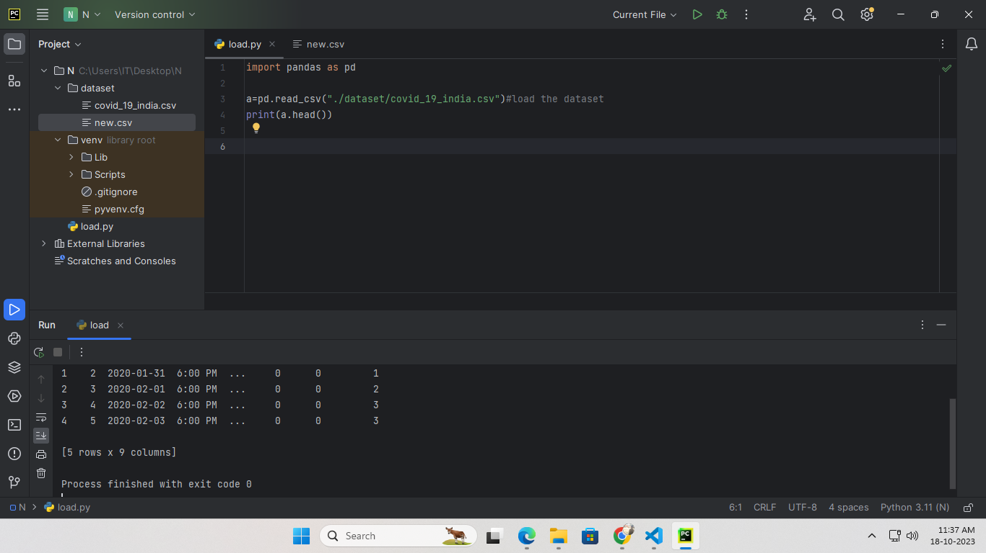
CODE:
Importing pandas and loading the dataset

Slide 7
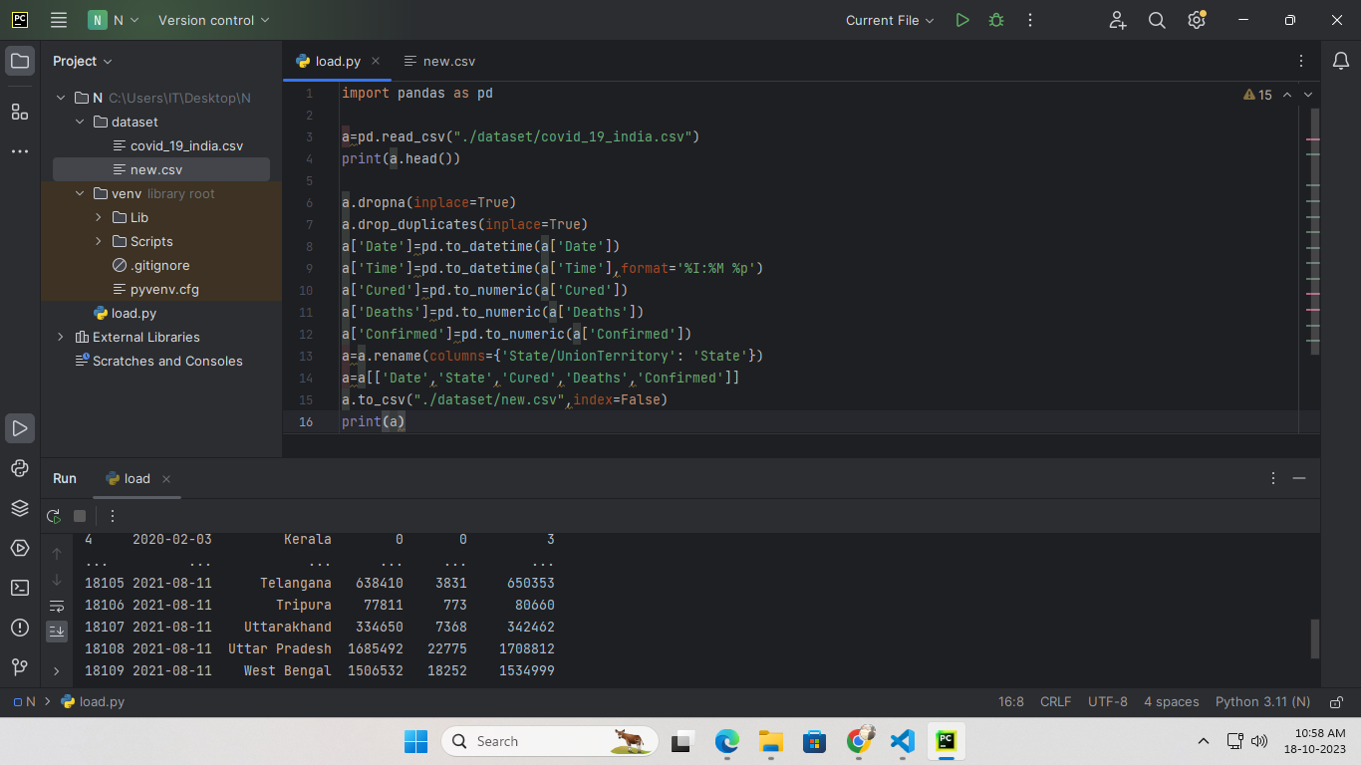
CODE:
Preprocessing the data and analysis

Slide 8
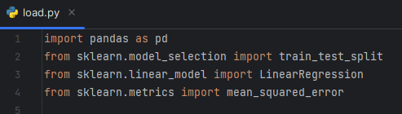
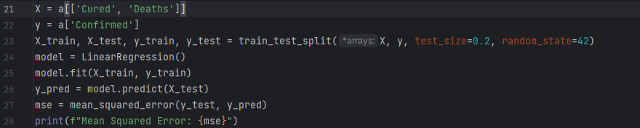
Importing Packages & Code

Slide 9
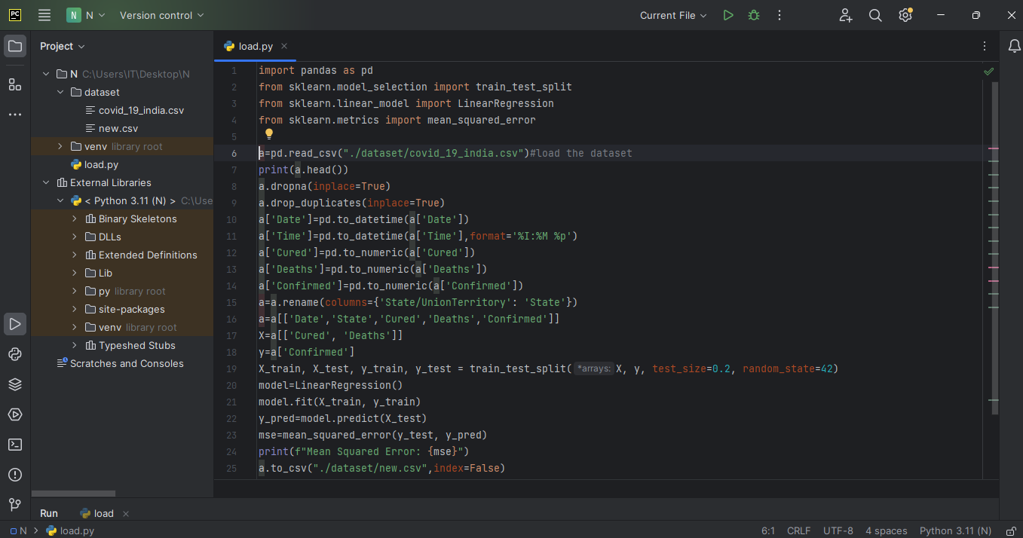
Whole Code:

Slide 10
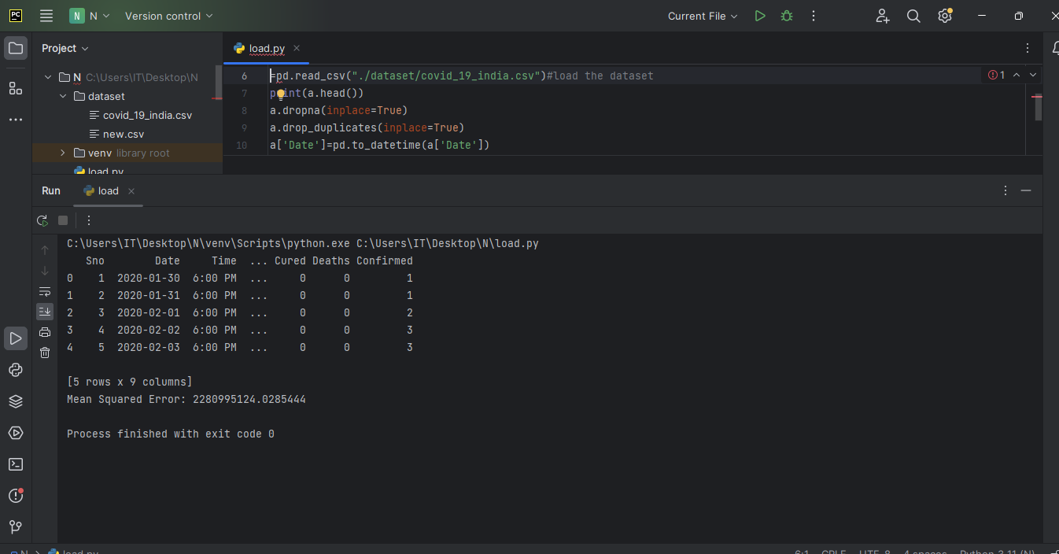
OUTPUT:

Slide 11
THANK YOU.

